Slide 1
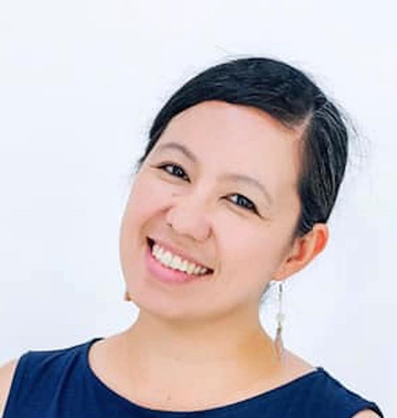
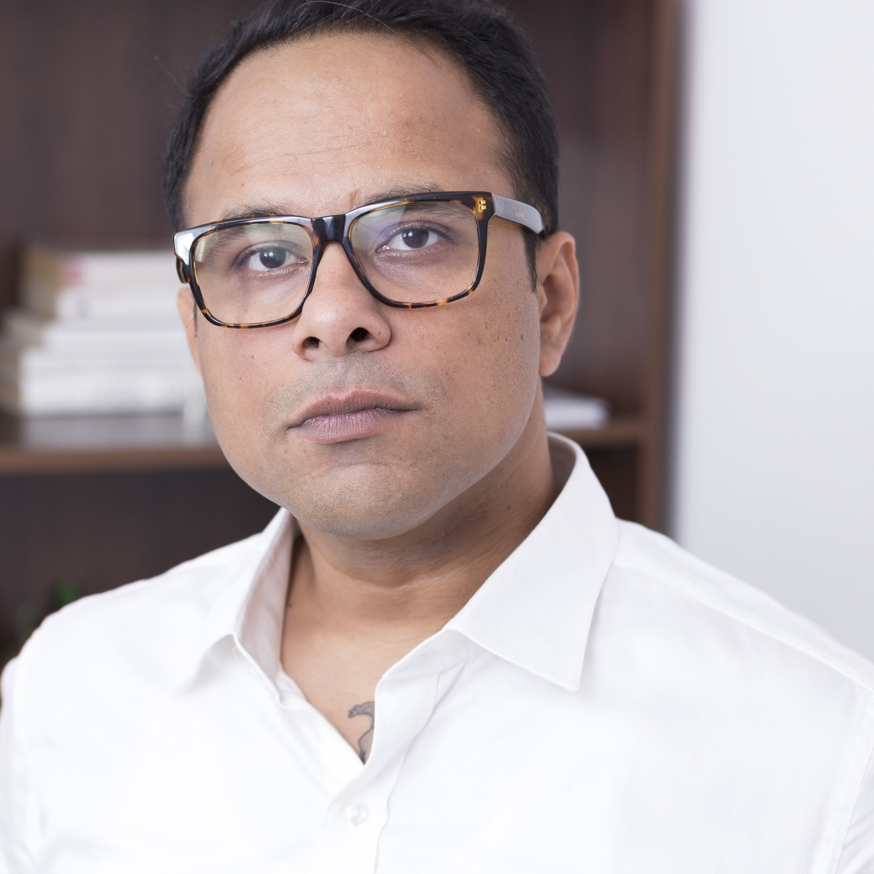
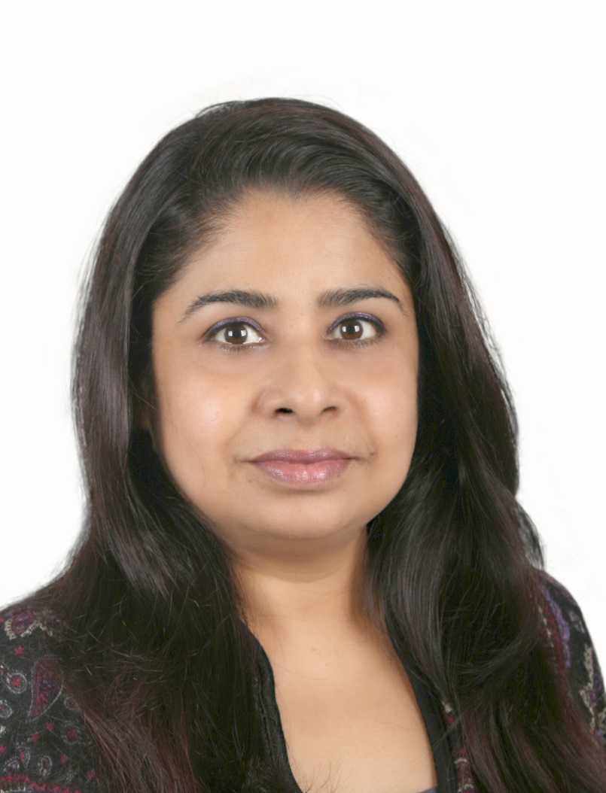
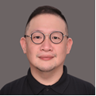
Teaching the MYP Way
Classroom Strategies and Assessments
27 November 2021
Meet the IB Workshop Leaders
GAY-ANN BAGOTCHAY
Science
Immersion School, Japan
JITINDRA PRASAD Language and Literature Stonehill International school, Bangalore
MAHNOOR ZEBA
I&S
Seisen International School, Tokyo
GURPREET KAUR
Mathematics
Gandhi Memorial International school, Jakarta
PATRICK ONG
Language Acquisition
Independent Consultant, Manila
Mr. Syed Akhil Ahmed Director, Commander Ali's Academy
of Merchant Navy
Mr. Masood Hussainy
Head, Aero structures and Aero-Engines
Tata Aerospace and Defence

